Slide 1

Model Exploration and Tuning for Optimal Performance
Alberto, Megan, Yassine, Yves

Slide 2
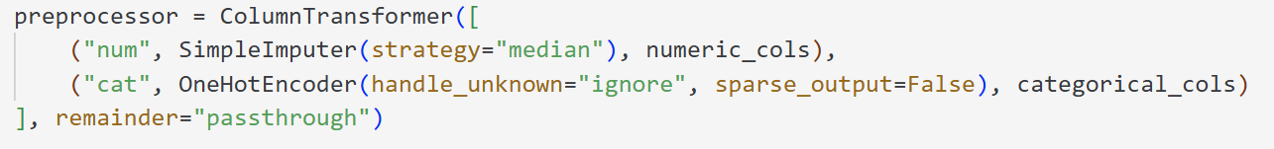
Preprocessing
Apply pre-processing pipeline (scikit-learn library)
Explanation
Numerical features are imputed using the median to handle missing values.
Categorical features are transformed using OneHotEncoder, which converts each category into binary columns.
Unknown categories are safely ignored (handle_unknown="ignore").
The ColumnTransformer keeps everything organized in a single preprocessing pipeline, ready to be integrated into a machine learning model.
Result
→ All data (numerical + categorical) becomes fully numeric and model-compatible → This pipeline is robust, reusable, and ensures clean preprocessing for training
Notes:
We apply a preprocessing pipeline using scikit-learn tools.
Numerical features: missing values are filled using the median to avoid bias.
Categorical features: encoded with OneHotEncoder to convert categories into binary columns.
Unknown categories during inference are safely ignored.
The whole process is wrapped in a ColumnTransformer pipeline.
Result: all features become numeric and ready for machine learning.
This approach ensures robustness, reusability, and clean data for training.

Slide 3
Model Exploration and Tuning for Optimal Performance
Model | Model Description | Advantages | Disadvantages
Linear Regression | Models relationship linearly between features and target using a weighted sum. | Simple, fast, interpretable | Cannot capture non-linear patterns
Random Forest | Ensemble of decision trees trained on random subsets of data and features. | Handles non-linearity, reduces overfitting | Can be slow with many trees, less interpretable
Polynomial Regression (Deg 2) | Extends linear regression by adding polynomial terms to capture curvature. | Captures simple non-linear relationships | Risk of overfitting, can be unstable with high degree
XGBoost (Baseline) | Gradient boosting ensemble of trees, sequentially improves errors. | High performance, handles missing data | Requires careful tuning, can overfit
XGBoost (Optuna tuning) | Same as baseline, but with hyperparameters optimized via Optuna. | Better generalization, improved accuracy | Computationally expensive tuning process
CatBoost (Baseline) | Gradient boosting with categorical feature support (no encoding needed). | Handles missing data, fast with categorical features | Requires tuning, less interpretable
CatBoost (Optuna tuning) | Same as baseline, with hyperparameter optimized via Optuna | Better generalization, robust with limited data | Computationally expensive, tuning still unstable
Notes:
We compared multiple models, each with strengths and limitations.
Linear Regression is fast and interpretable, but can’t capture non-linear patterns.
Random Forest handles non-linearity and reduces overfitting, but can be slow and less interpretable.
Polynomial Regression captures basic curvature, but easily overfits.
XGBoost performs well and handles missing data, but requires careful tuning.
With Optuna, we tuned key hyperparameters:
number of iterations,
tree depth,
learning rate,
and regularization.
This hyperparameter tuning improves generalization but is computationally expensive.
CatBoost, with native support for categorical features, is efficient but less interpretable.
Tuned CatBoost with Optuna gave the best results overall, though tuning remained costly and somewhat unstable.

Slide 4
Train/Test Strategy & Feature Selection
Train / Test Strategy
Feature Selection Strategy
Train/Test split (80/20) used for all models
For XGBoost and CatBoost, tuning was done via 5-Fold Cross Valdiation on the training set
(no separate dev set)
The test set was kept untouched for final evaluation
In test mode, we reduced folds (i.e., the number of train/validation splits in cross-validation) and sample size
→ to speed up Optuna trials
Initial feature set reduced by removing low-variance features (Variance Threshold)
Top 30 features identified with Random Forest feature importance
Models trained & evaluated on:
Full reduced feature set
Top 30 feature subset
The goal is to balance between
model performance
and simplicity
Notes:
--- Train / test strategy ---
We followed a standard 80/20 Train/Test split for all models.
For XGBoost and CatBoost, we used 5-Fold Cross Validation on the training set
This means : -> the training data is split into 5 parts;
->each part is used once for validation while the others are used for training.
The test set stayed untouched until final evaluation.
In test mode,
-> we reduced folds and sample size to speed up Optuna tuning.
--- Feature selection ---
We first removed low-variance features using a Variance Threshold.
-> features that vary very little and don’t help prediction.
Then, we selected the top 30 most important features using Random Forest.
XGBoost & Catboost were trained on both:
The full reduced set,
and the top 30 features only.
This helped us compare performance and simplicity,
-> and test if fewer features could still give good results

Slide 5
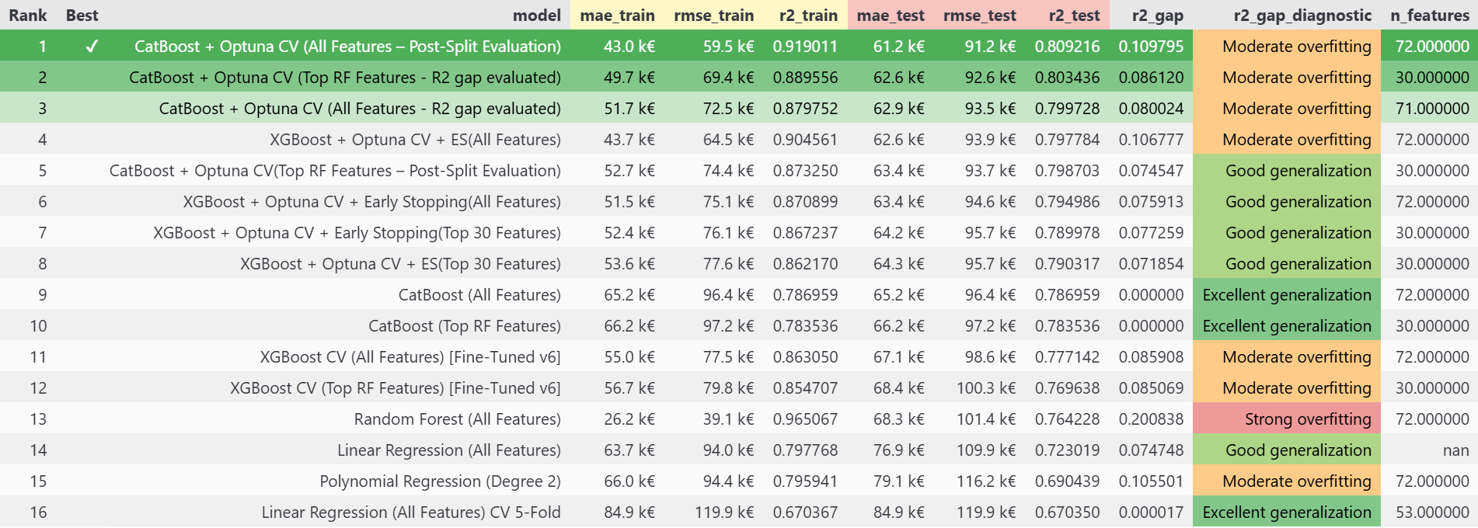
Train vs Test Metrics Interpretation
Train vs Test:
Train metrics reflect the model’s performance on data it has already seen
Test metrics evaluate how well the model generalizes to unseen data
A good model should have small gaps between train and test performance.
MAE Gap:
Difference in MAE (Mean Absolute Error) between train and test sets
A large gap indicates the model may be fitting noise (→ risk of overfitting)
R² Gap:
Measures the drop in explained variance (R²) from train to test.
A large R² gap implies the model does not generalize well.
Overfitting:
The model learns training data too well but fails to generalize.
Seen in low train error and high-test error (e.g. Rank 13 – Random Forest).
Diagnosed by large MAE gap and R² gap.
Underfitting:
The model is too simple and fails to learn the data structure.
Low R² on both train and test sets with small gaps.
Example: Linear Regression (Rank 15) shows poor test R² (0.69) and high error
→ underfitting behavior.
Notes:
Best Model: CatBoost + Optuna + Post-Split Evaluation reaches 0.81 R²_test & 0,92 R2_test with moderate overfitting. (Post-split = re-evaluation after tuning, on fresh data)
good train performance,
slightly worse on test
The model captures useful patterns
but also some noise, leading to moderate overfitting. (R2 gap is 0.1)
XGBoost benefits from early stopping (stops training when the model stops improving).
Random Forest shows strong overfitting (perfect on train, poor on test).
Linear models underfit → too simple for this task.
----------------------------------------------
A large MEA gap indicates the model is learning patterns that are specific to the training data, → including random
A large R2 gap implies the model does not generalize well
-> The model learns patterns specific to training data, including noise.
-> (it strongly overfits)
Moderate overfitting = good train performance, slightly worse on test → some patterns too specific.
Good generalization = consistent train/test scores → model captures true structure.

Slide 6
Challenges in Predictive Modeling with Immoweb Data
Hyperparameter tuning was time-consuming, even with GPU acceleration, especially for complex models like XGBoost, LightGBM, and CatBoost using Optuna and cross-validation
Finding the right balance between underfitting and overfitting is tricky, especially with limited data or noisy features
Despite multiple tuning attempts, models often showed instability, with fluctuating performance metrics
Achieving stable and reliable tuning results took more iterations than expected, and the process is still not fully optimized
Stable and reproducible results required 100+ Optuna trials per model, using multiple validation methods (KFold, train/test split).
This can be challenging when the training window is short
Limited time for tuning increases the risk of suboptimal and unstable results
Notes:
Hyperparameter tuning was very time-consuming, even with GPU, especially with complex models like XGBoost and CatBoost. -> We used Optuna with cross-validation (splitting data into folds to ensure robustness),
-> which added to the computation time.
Finding the balance between underfitting and overfitting was tricky,
-> due to missing or noisy features like epcScore or kitchenType.
Getting stable results required over 100 trials per model, and multiple validation methods like K-Fold (splitting data into K parts and rotating train/test sets)
And this gets harder when the training window,
-> meaning the actual time we have to run experiments is short.

